Slide 1
Live Demo
Click to launch the Streamlit app
Open AI-MCN Demo
What I will do in live demo
Explain every tab from input to export.
Define each important metric in business language.
Then return to slides for BOJ action plan and beauty-industry insights.
Source: AI-MCN Streamlit prototype
1 / 15

Slide 2
Live Demo Roadmap
All tabs will be explained
1) Campaign Input
2) Overview
3) Top Matches
4) Network Studio
5) Text Intelligence
6) ML Studio
7) ROI Lab
8) Content Strategy
9) Executive Memo / Glossary / Export
Audience should watch for
How score is built and controlled.
How reliability changes shortlist quality.
How content + ROI decisions are connected.
How BOJ can act immediately after this run.
Source: AI_MCN_Demo_DeepDive_Script_EN.md
2 / 15

Slide 3
Live Demo Checkpoint
What each tab must answer
Decision questions
Metric meanings to explain live
Who should BOJ contact first?
Why are those creators recommended?
How much evidence supports each recommendation?
What budget plan is realistic?
What content format should each creator publish?
Final Score = suitability after reliability adjustment.
Evidence Score = scale/activity/interaction support.
Community ID = network cluster label.
TF-IDF/Semantic/Tone = message-fit signals.
ROAS range = planning scenario band.
Source: Top Matches + Network + Text + ROI tabs
3 / 15

Slide 4
BOJ Context: Why This Client Case Matters
Business context
Why this case is strong for demo
BOJ is a K-beauty brand expanding in global skincare markets.
Demo product: Relief Sun SPF + Glow Serum.
Campaign problem: find creators with both relevance and purchase intent.
Operational pain: manual creator screening is slow and inconsistent.
Clear product story and clear target audience.
Keyword-rich skincare category for text-fit diagnostics.
High sensitivity to creator-message alignment quality.
Realistic benchmark comparison in U.S. skincare context.
Source: NIQ 2025 K-beauty report + BOJ U.S. strategy references
4 / 15

Slide 5
BOJ Run Facts (Actual App Output)
Core run stats
Benchmark + ROI context
Videos analyzed: 42,750
Channels scored: 1,089
Best ML model: LightGBM
Top-10 mean final score: 0.307
Top-10 mean evidence score: 0.702
Top-10 community coverage: 2
Reference brand: CeraVe
Reference top channel: Dr. Usama Syed
BOJ Top-N mean: 0.307
CeraVe Top-N mean: 0.260
Gap (BOJ - benchmark): +0.047
ROI baseline: 1.14x (range 0.80x-1.48x)
Source: presentation_summary_boj.json
5 / 15

Slide 6
BOJ Top-10 Recommended Influencers (Actual Output)
Top-10 list
Role split recommendation
#1 Robert Welsh (0.394)
#2 Tati (0.327)
#3 Beauty Within (0.324)
#4 STEPHANIE TOMS (0.318)
#5 MrsMelissaM (0.307)
#6 Dr Alexis Stephens (0.307)
#7 Mad About Skin (0.283)
#8 Just Beauty by Julie P - makeup, beauty reviews (0.273)
#9 James Welsh (0.270)
#10 Morgan Turner (0.270)
Scale/Awareness: Robert Welsh, Tati, Beauty Within, James Welsh, Morgan Turner
Conversion/Fit: STEPHANIE TOMS, Mad About Skin
Education/Support: MrsMelissaM, Dr Alexis Stephens, Just Beauty by Julie P - makeup, beauty reviews
Use different creative objective by role, not one message for all creators.
Source: top10_beauty_of_joseon.csv
6 / 15

Slide 7
Representative Deep Dive: #1 Robert Welsh
Channel profile (from current output)
Business interpretation + content recommendation
Final score: 0.394
Evidence score: 0.743
TF-IDF: 0.311
SNA: 1.000
n_videos used: 22
Median views: 39,296
Recent publish: 2026-02-24
Why useful for BOJ:
Very strong skincare-language match to campaign intent.
Good context for sensitive-skin sunscreen storytelling.
Role in this run: Awareness-focused
Recommended content package:
Primary: Concept 1 (Daily Routine)
Backup: Concept 3 (Q&A Conversion Hook)
Product angle: lightweight daily SPF for sensitive/acne-prone users
Source: top10_beauty_of_joseon.csv (row #1)
7 / 15

Slide 8
BOJ Channel-to-Content Strategy Mapping
Top-10 concept mapping
4-week execution cadence
Concept 1 (Daily Routine): Robert Welsh, Tati, Beauty Within, James Welsh, Morgan Turner
Concept 2 (Results Comparison): STEPHANIE TOMS, Mad About Skin
Concept 3 (Q&A Hook): MrsMelissaM, Dr Alexis Stephens, Just Beauty by Julie P - makeup, beauty reviews
Assign creator objective before budget allocation.
Week 1: Awareness launch
Week 2: Education + routine detail
Week 3: Product proof/comparison
Week 4: Conversion CTA + recap
Then re-rank with weekly KPI feedback
Source: Content Strategy tab + memo campaign structure
8 / 15

Slide 9
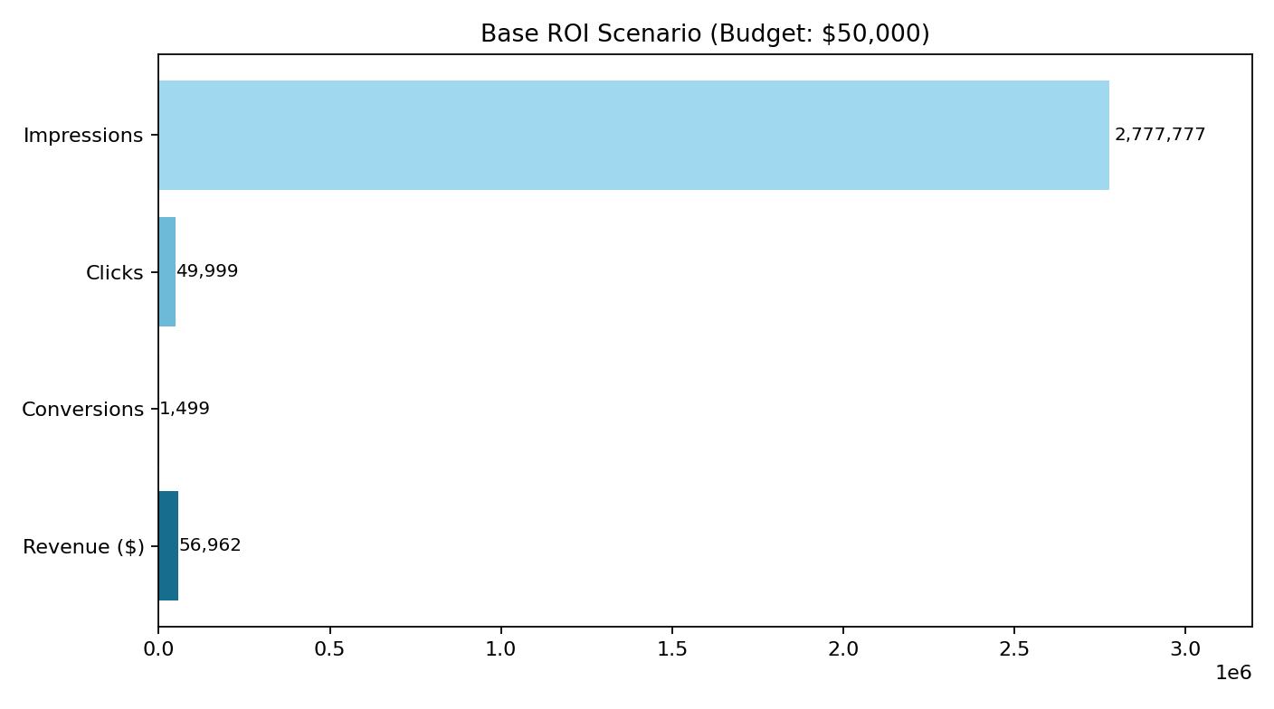
BOJ Budget Allocation Scenario (Current Run)
Example allocation outputs
Assumption + interpretation
Robert Welsh: Budget $5,674 | Conv~170 | Revenue~$6,465
Tati: Budget $5,651 | Conv~169 | Revenue~$6,438
Beauty Within: Budget $5,222 | Conv~157 | Revenue~$5,949
James Welsh: Budget $5,136 | Conv~154 | Revenue~$5,851
Dr Alexis Stephens: Budget $4,984 | Conv~149 | Revenue~$5,678
Allocation weight = 55% final score + 25% evidence + 20% reach index
Scenario budget total: $49,999
Scenario conversions total: 1,498
Scenario revenue total: $56,963
Reach-heavy creators support awareness speed.
Fit-heavy creators support conversion quality.
Source: presentation_summary_boj.json + derived allocation scenario
9 / 15

Slide 10
Analysis-to-Action Framework for BOJ
From analysis to decision
Practical guardrails
Top Matches: use as shortlist, not final spend decision alone.
Evidence/Multiplier: core spend only above evidence threshold.
Text Intelligence: conversion creatives only for high fit channels.
Network Studio: enforce community diversity in active spend.
ML Studio: validate score stability before large reallocations.
ROI Lab: use scenario ranges for budget approval.
Do not allocate budget by rank only.
Apply pilot cap to low-activity channels.
Review KPI weekly and rerank creators.
Track model rationale and risk flags in exports.
Source: Top Matches + Network + Text + ML + ROI tabs
10 / 15

Slide 11
BOJ 30-60-90 Day Operating Plan
0-30 / 31-60 days
61-90 days
0-30: Launch Top-10 with tiered budget and clean tracking links.
0-30: Use 3 lead creators + 4 support creators + 3 pilots.
31-60: Re-rank using CTR/CVR/ROAS.
31-60: Shift budget from weak pilots to strongest converters.
31-60: Update include/exclude keywords from comment feedback.
Build BOJ creator playbook by audience sub-segment.
Segment examples: sensitive skin / acne-prone / lightweight SPF seekers.
Run monthly benchmark vs competitor profile.
Keep export-based audit trail for every campaign cycle.
Source: Execution plan derived from BOJ run outputs
11 / 15

Slide 12
BOJ KPI Governance (Weekly)
Core KPI stack
Decision rule example
CTR
CVR
ROAS
Branded search lift
Comment quality and repeated objections
Community concentration ratio
Increase: above-target CVR + stable evidence.
Hold/test: mixed performance but strategic niche relevance.
Reduce/exit: weak CVR + low evidence + off-message signals.
Re-run ranking after every major budget shift.
Source: ROI + Text + Bias diagnostics
12 / 15

Slide 13
Beauty Industry Insight #1 (from this run)
Observed pattern
Recommended portfolio structure
High reach and high semantic fit are often different creators.
Single flat top-list design can waste spend.
Role-split creator portfolio performs better operationally.
Awareness track (reach-driven)
Conversion track (fit/evidence-driven)
Controlled test track (small pilot budget)
Rebalance across tracks by weekly KPI
Source: BOJ Top-10 signal pattern
13 / 15

Slide 14
Beauty Industry Insight #2: Scalable Operating Model
Repeatable campaign cycle
Governance and audit trail
Input brief -> explainable ranking -> strategy mapping -> ROI scenarios -> export
Run this cycle every launch, not as one-off analysis.
Use benchmark panel monthly against competitor profiles.
Keep rationale text for each selected creator.
Track risk flags and evidence movement over time.
Store exported files for post-campaign review.
Standardize framework across skincare/makeup/haircare.
Source: AI-MCN pipeline + export architecture
14 / 15

Slide 15
Closing
For BOJ, this output is not only a recommendation list; it is an execution plan.
For beauty brands, AI-MCN turns influencer marketing into measurable decision operations.
This is how we replace manual MCN-style matching with explainable AI workflow.
Thank you. Q&A
Source: AI-MCN demo output synthesis
15 / 15

